Slide 1
Secretariat support services
BERT MEERMAN
Member Steering Group

Slide 2
Scope
The EOSC Secretariat, effectively delivering 360° support to the EOSC Governance (notably the Executive Board), works openly and inclusively together with communities to co-create an all-encompassing European Open Science Cloud.

Slide 3
Guiding principles
Independency & neutrality
Working for and under the supervision of the EB
Interim character, with an enabling and advisory approach
Supporting a user centric EOSC implementation, with the Co-creation budget at the command of the EB
Flexibility & agility
Transparency & openness

Slide 4
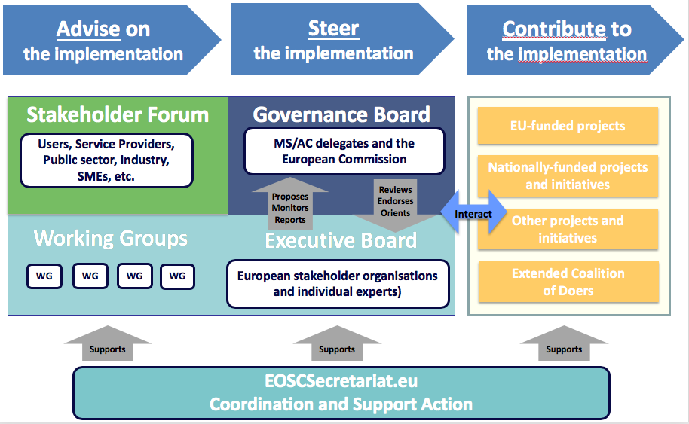
EOSC Governance

Slide 5
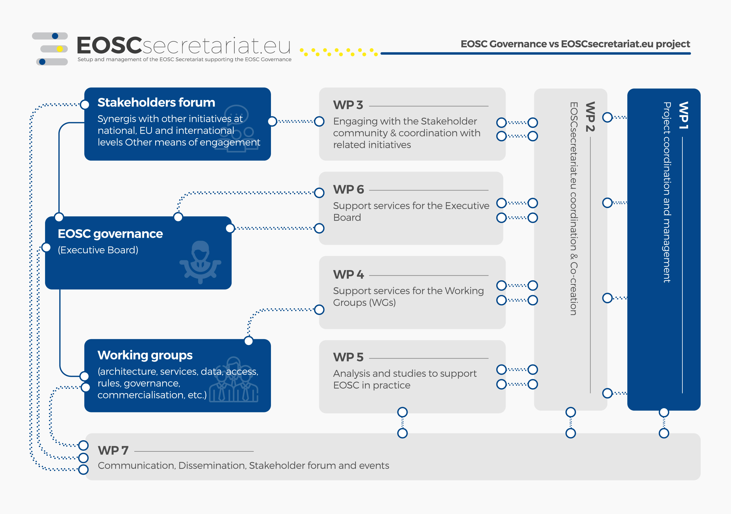
Our services

Slide 6
Tasks of WP 3.4 and WP7.2 International Initiatives
Define, Engage and Onboarding of Stakeholders
Execute Questionnaires in order to manage expectations
Set up two-way communication with stakeholders
Gather input from the community and from int’l initiatives.
Inform about progress at EOSC level.
Inform on FAIRsFAIR, Nordic FAIR, EOSC 5B Projects and EOSC Hub.
Organize info-sessions and/or webinars.
Define and promote common / best practices to EOSC
Guide stakeholders with co-creation opportunities
Guide stakeholders to participate in EOSC WG’s.

Slide 7












Our team
Consortium
TGB
UKRI
ARC
CERN
CNR-ISTI
GEANT
GO FAIR
KIT
TUWIEN
Trust-IT
CSC

Slide 8
CO-CREATION BUDGET AND REQUEST FORM
Co-creation budget
EOSCSecretariat.eu retains a high degree of flexibility in its roll-out plan by adopting a co-creation approach and providing budget for all upcoming, foreseen and unforeseen, activities and actions related to the work of the EOSC Secretariat to support the EOSC Governance.
2. Who can apply for co-creation activities?
Individuals or natural persons residing in the Member States of the European Union (EU), including their outermost regions and the associated countries (AC)
Applicants who are not receiving support from other instruments (EU or national Research Infrastructure projects) for the proposed activities, and are not being funded from other sources for an identical activity
Notes:
What who how

Slide 9
CO-CREATION BUDGET AND REQUEST FORM
What are the application and evaluation criteria?
Eligibility according to H2020 criteria
Activities and actions which are related to the work of the EOSC Secretariat to support the EOSC Governance, in particular the activities of the Executive Board Working Groups, the Governance Board Sub Groups and the Stakeholder Forum
Added value to existing EOSC activities
Quantified benefits for the EOSC/KPIs and the corresponding outcome
4. Process of the request
Send Request Form
Analysis / consistency check by EOSC Secretariat
Phase for adjustments
Evaluation process by Secretariat Steering Group
Decision: Approval or rejection
(appr. 30-45 days)
Notes:
What who how

Slide 10
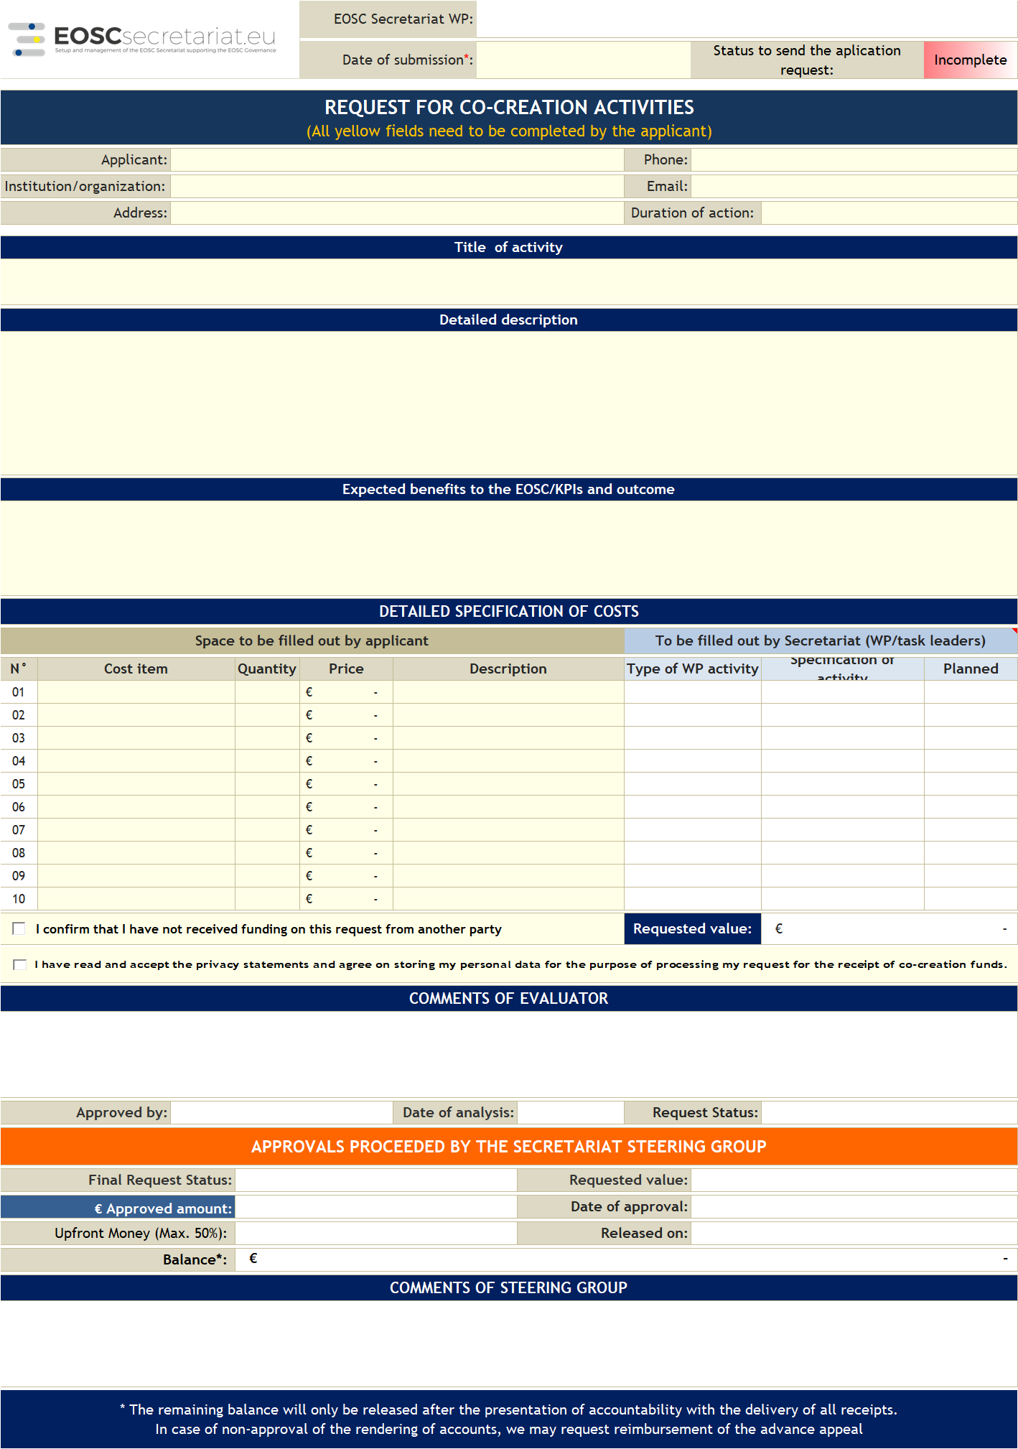
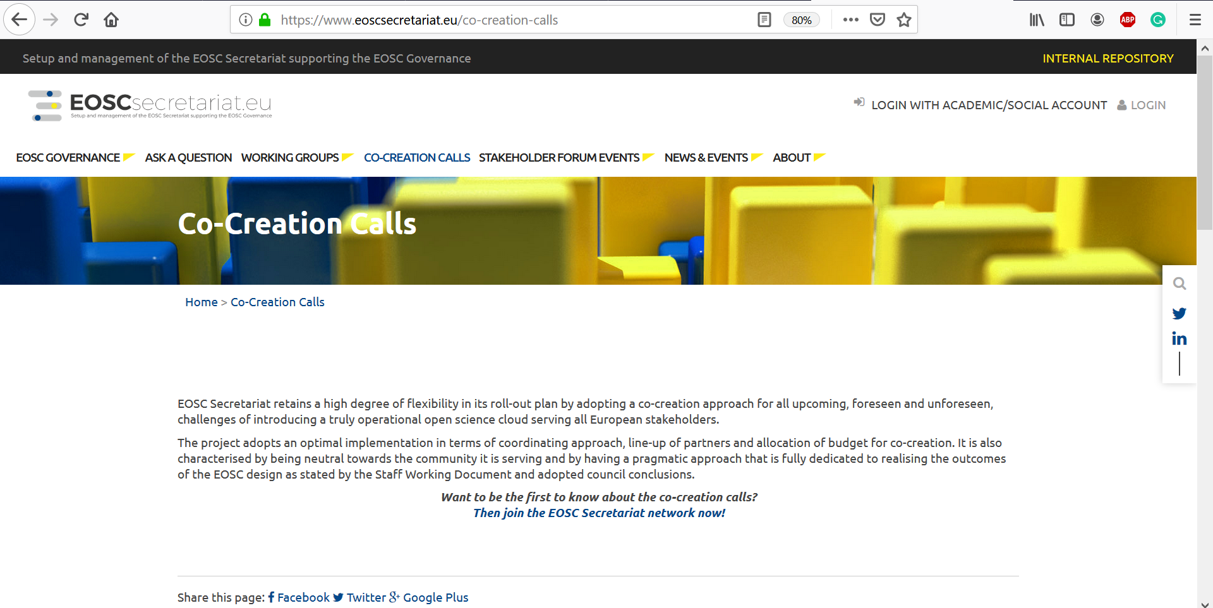
CO-CREATION BUDGET AND REQUEST FORM
5. Where to apply
6. The request form
https://www.eoscsecretariat.eu/co-creation-calls
> For any questions, please contact cocreation@eoscsecretariat.eu
Notes:
What who how

Slide 11
Co-Creation opportunities for GEDE, like :
PID Service ( Handle / DOI’s)
EduGain service extension
Digital Object model - FAIR DO.
Semantic Mapping exercise
GDPR implications for data-exchange
Research Workflow Automation use case or pilot.

Slide 12


What you can do
The EOSC Secretariat is at the heart of the activities happening around EOSC. Sign up to our community to receive immediate updates. Here's how you can take a more active role under the EOSC Secretariat:
Benefit from the co-creation funding
Contribute to the Working Groups
Bring your assets to EOSC
Shape the EOSC 2021 by joining the EOSC Stakeholder Forum
PROPOSED STEP 1 : Setting up a TWO-WAY COMMUNICATION STREET

Slide 13
For further questions and information:
Contact us www.eoscsecretariat.eu/contact-us
Email info@eoscsecretariat.eu
Join Webinar – Monday July 1°.
https://www.eosc-portal.eu/events/webinar-building-european-open-science-cloud

Slide 14




Get in touch via mail or on our channels
Thank you!
BERT MEERMAN
Director
GO FAIR FOUNDATION
info@eoscsecretariat.eu
www.eoscsecretariat.eu
@EoscSecretariat
EOSC Secretariat

